Slide 1

Power BI Import Mode vs Direct Query
Pr. Abdessamad BENLAHBIB

Slide 2
Introduction
When connecting to data in Power BI Desktop, one of the first things each Power BI developer needs to know is whether to click the Import or Direct Query box. Before choosing on which strategy is ideal for you, you need to think about a few things. This decision can be made based on the report, but your company should have a strategy in place for how to employ both of these ways. Let’s go over each connection method one by one and find out what is better when it comes to Power BI Import vs Direct Query.

Slide 3
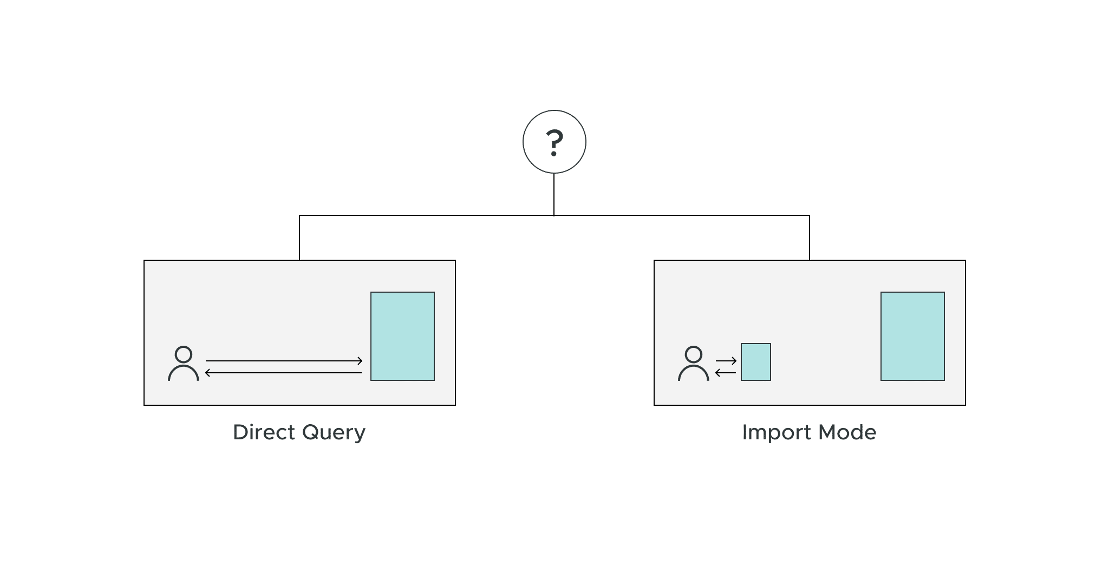
What is Direct Query and Import Mode in Power BI?

Slide 4
What is Direct Query and Import Mode in Power BI?

Slide 5
What is Direct Query and Import Mode in Power BI?
Direct Query – When you connect a data source using the Direct Query technique, your dashboard will query the data source immediately during runtime. Each filter and interaction with the report will result in a series of new queries. Since no data is imported into Power BI, the user can always query the data that already exists in the data source.
Each & every single request goes straight to the data source (which is more often SQL database) and pulls the data from there into Power BI.

Slide 6
What is Direct Query and Import Mode in Power BI?
Import — Using the Import mode of connection, Power BI will cache the data you’re linked to, providing a snapshot of your data at a specific point in time. All of your data’s interactions and filters will be applied to this compressed cache source rather than the original data source.

Slide 7
Is Direct Query faster than Import Mode in Power BI?
Import mode is the best option if your data is less than 1 GB and isn’t constantly updating. Because all data comes from the Power BI Desktop Cache. So in such scenario, an import mode is faster than Direct Query mode when the data file size is below 1 GB.

Slide 8
Import Mode Vs Direct Query Mode
Feature | Import | DirectQuery
Size | Up to 1 GB per dataset | No limitation
Data Source support | Import data from Multiple sources | Data must come from a single Source
Performance | High-performance query engine | Depends on how fast the network connectivity and data source is as queries are executed in real-time. Only metadata and schema structure is stored on the Data model
Schedule Refresh | Maximum 8 schedules per day | Schedule often as every 15 mins

Slide 9
Import Mode Vs Direct Query Mode
Feature | Import | DirectQuery
Data Transformations | Supports all transformations | Supports many data transformations with some limitations
DAX expressions | Supports all DAX functions | Restricted to use complex DAX functions such as Time Intelligence functions. However, if there is a Date table available in the underlying source then it supports
Calculated Tables | Available | Not supported
Target Audience | Small and Medium Datasets | Large Datasets (Greater than 1 GB)

